Slide 1





TRAVEL
BLOG

Slide 2
Rima Alharbi
Dana Al-Wasabi
Hanadi Al-Rashidi
Bushra Al-Rahili
Rawabi Al-Rashidi
Presented by :
Supervised by:
Dr.Rahmah Brnawe

Slide 3

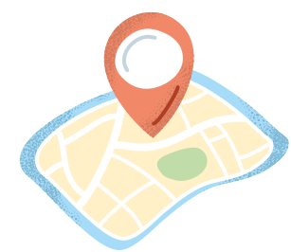
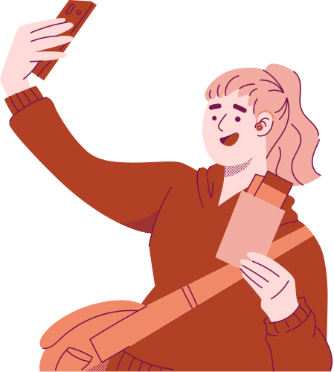
Table of contents
Introduction
Problem Definition
Project Objectives
Similar Businesses to Our Website
TOOLS AND LANGUAGES
DATABASE
USER INTERFACE
CONCLUSION

Slide 4



Introduction
We are working on a website dedicated to tourism in Saudi Arabia, aiming to provide a reliable and comprehensive source of information for tourists and residents who face challenges in finding information about tourist destinations, restaurants, and hotels

Slide 5



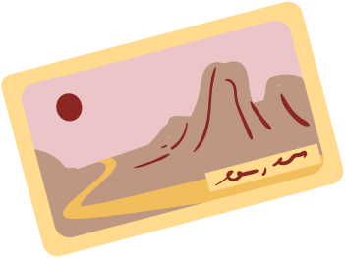

Problem Definition
Tourists and residents face difficulties in tourism in the Kingdom of Saudi Arabia, and these difficulties stem from a lack of guidance regarding the best products, foods, hotels, and tourist attractions in general

Slide 6
Project Objectives:
1. Provide reliable information based on personal experiences.
2. Encourage exploration of new places and cultures.
3. Build an interactive community for travelers to share ideas and experiences.

Slide 7
Similar Businesses to Our Website:
Sites like Travel Blog.com and Thedollzter offer reviews and valuable information for tourists.
However, we strive to make our website more distinctive by providing an efficient and secure design that offers an enhanced user experience. Additionally, we aim to contribute to the promotion of the tourism sector and cultural heritage in the Kingdom by introducing a feature that allows users to rate and share their experiences, along with personal photos of the places they’ve visited.

Slide 8
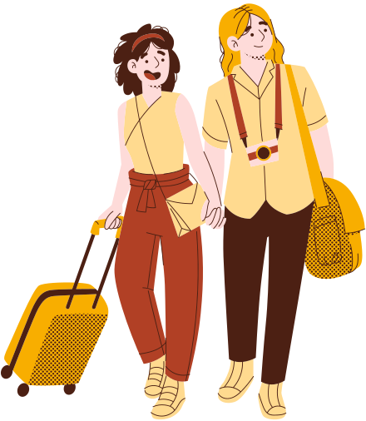

TOOLS AND LANGUAGES
Markup language: HTML
Program language: PHP - HTML - JavaScript - MySQL
Content management system by : It was built using PHP code and MySQL for data management

Slide 9
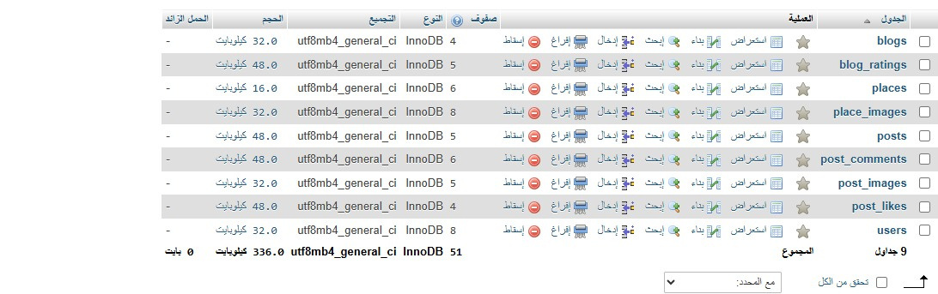
DATABASE
DATABASE :

Slide 10
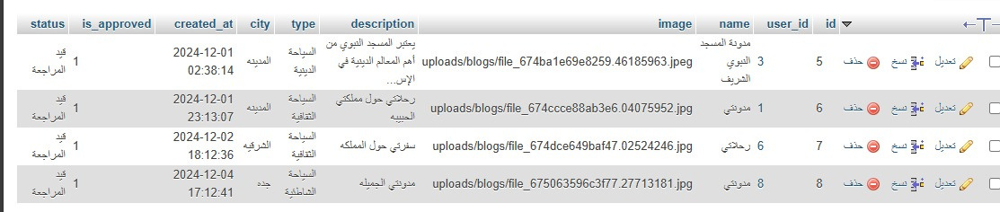
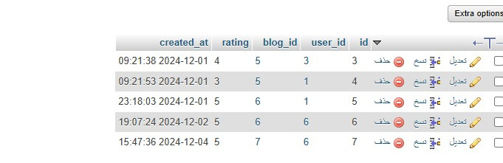
Blogs
The Blog Rating

Slide 11
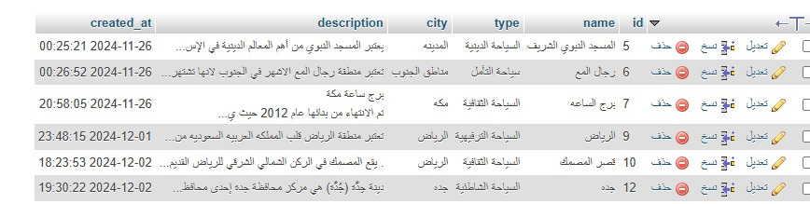
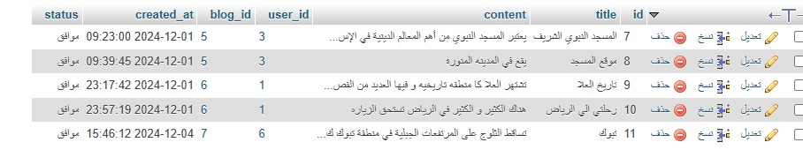
Famous Places
Posts within the blog

Slide 12
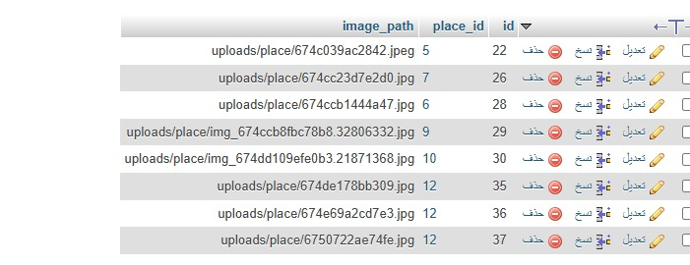
Pictures of famous places

Slide 13
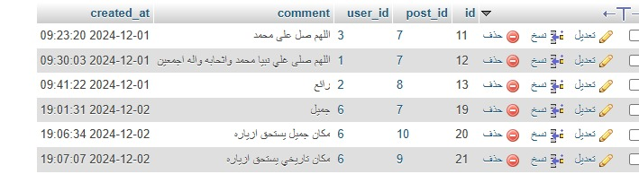
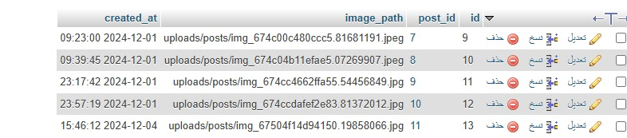
Comments
Publications

Slide 14
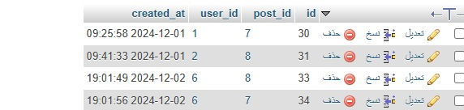
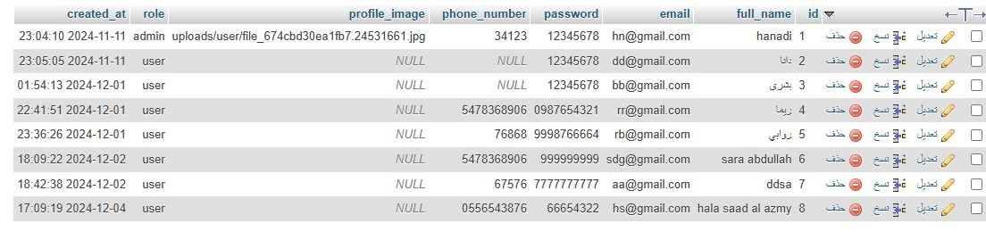
Likes for posts
Users Table

Slide 15
User Interface

Slide 16
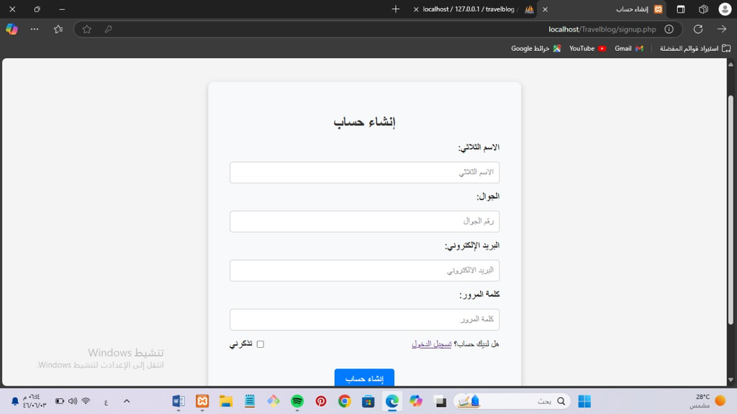
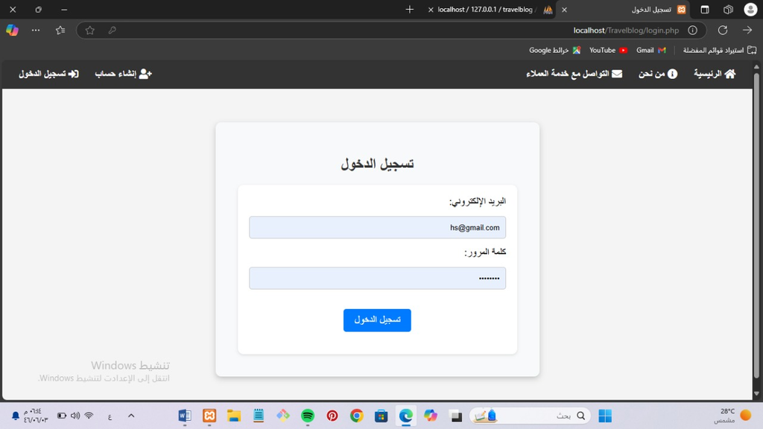
Registration Page
Login Page

Slide 17
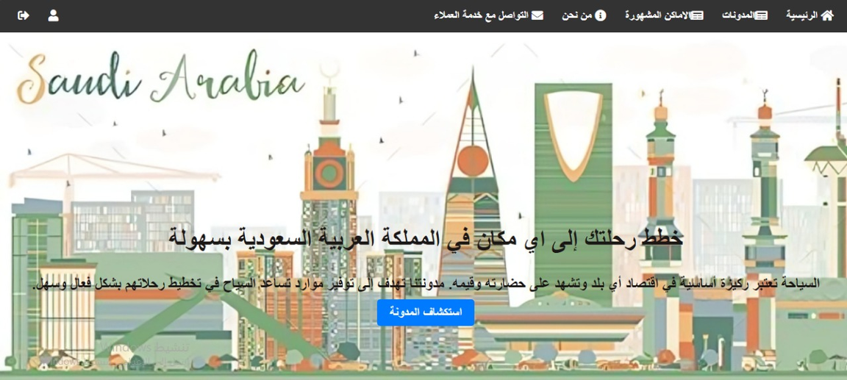
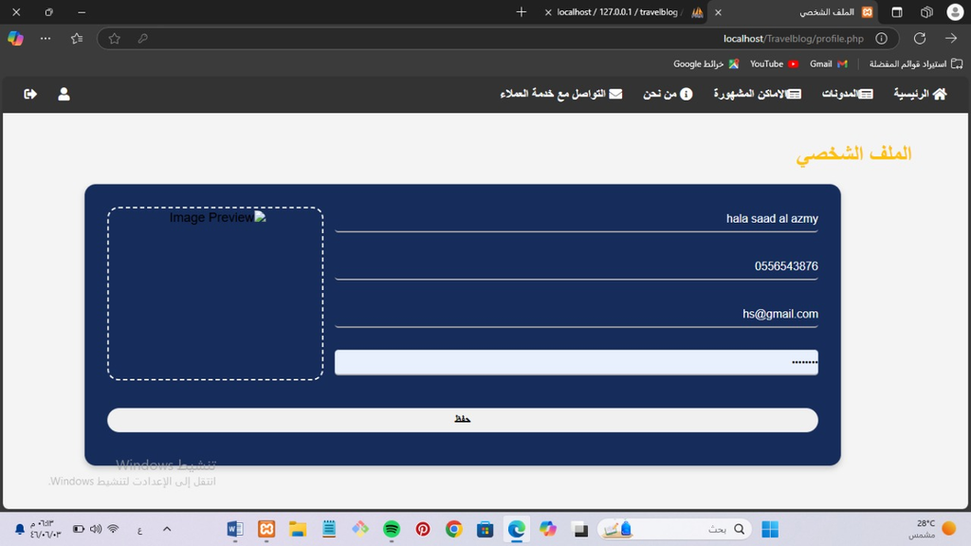
Home Page
Information Page

Slide 18
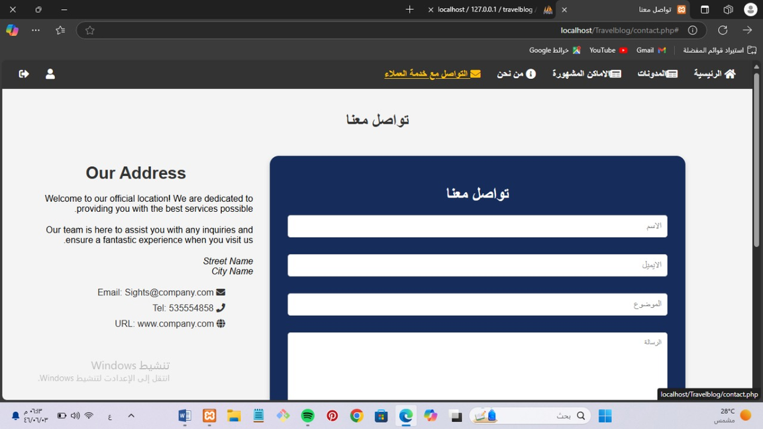
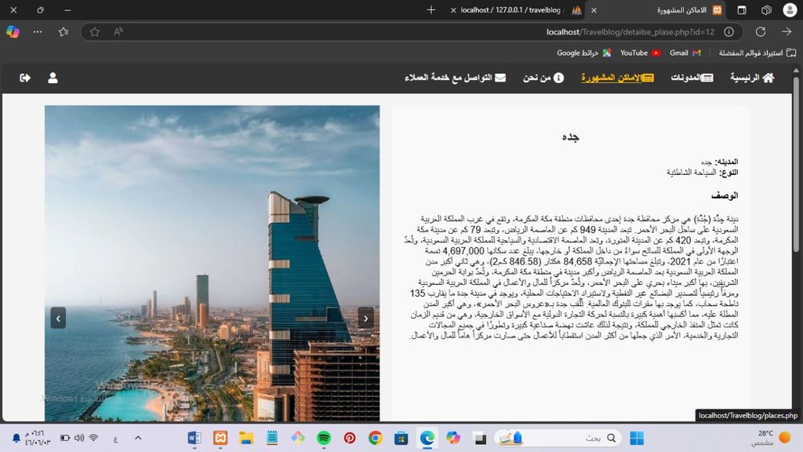
Admin's famous places page
User's Famous Places Page

Slide 19
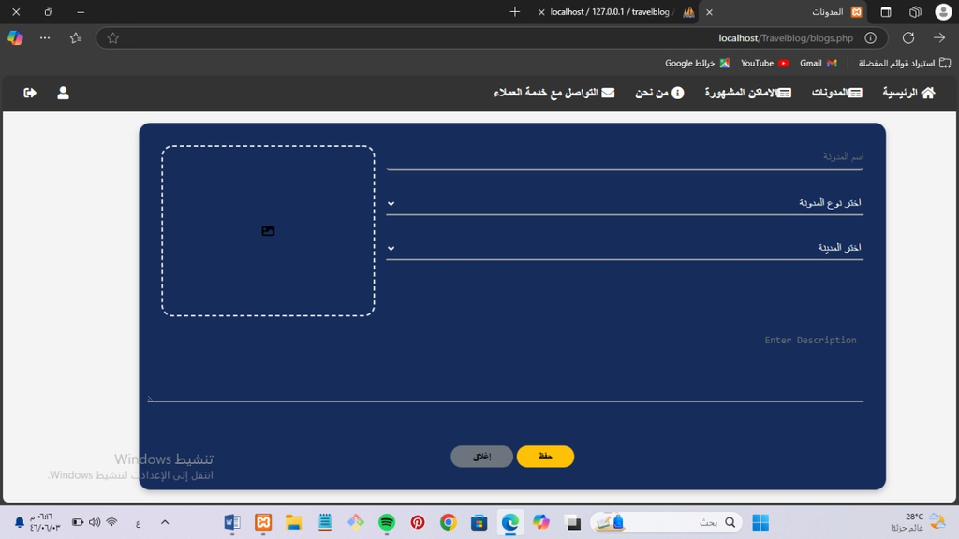
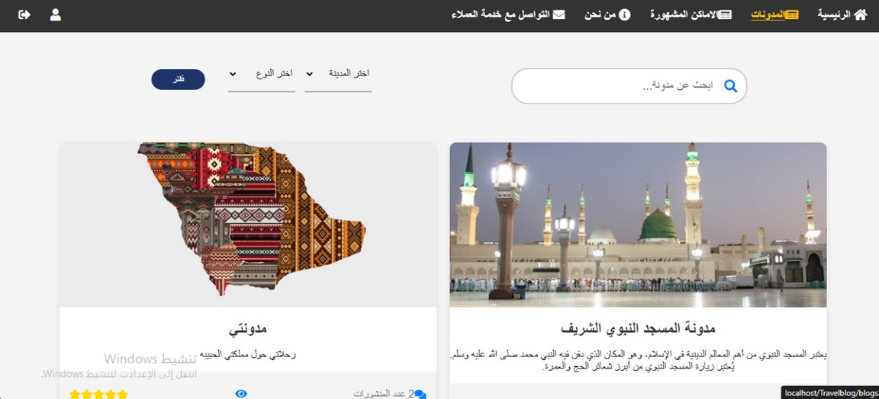
Add blog page
Blog page of our site by user

Slide 20
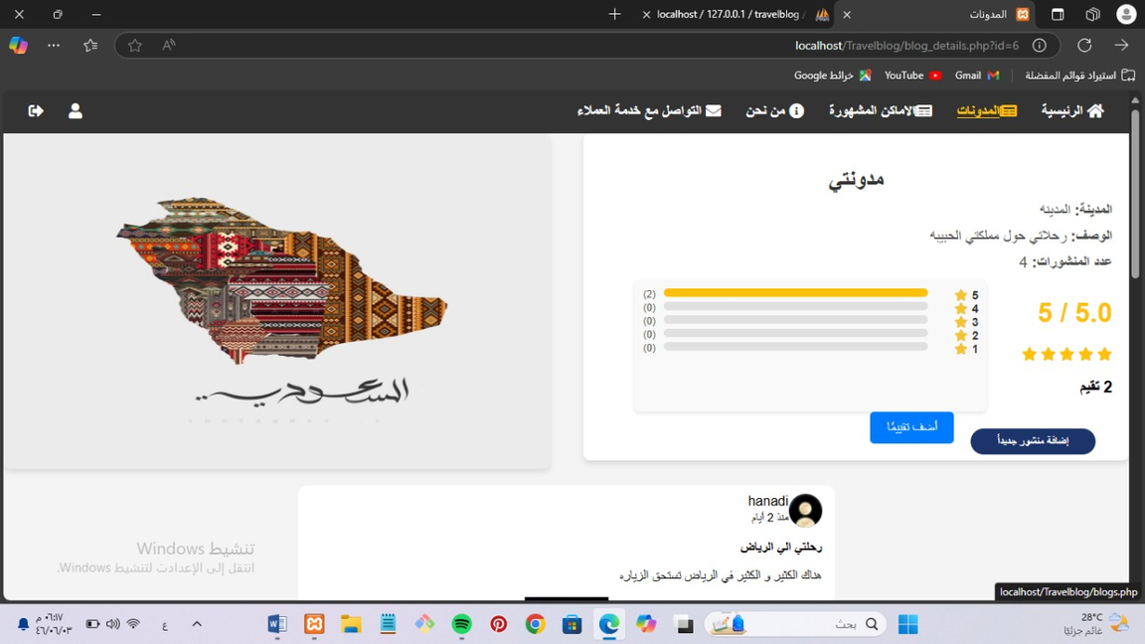
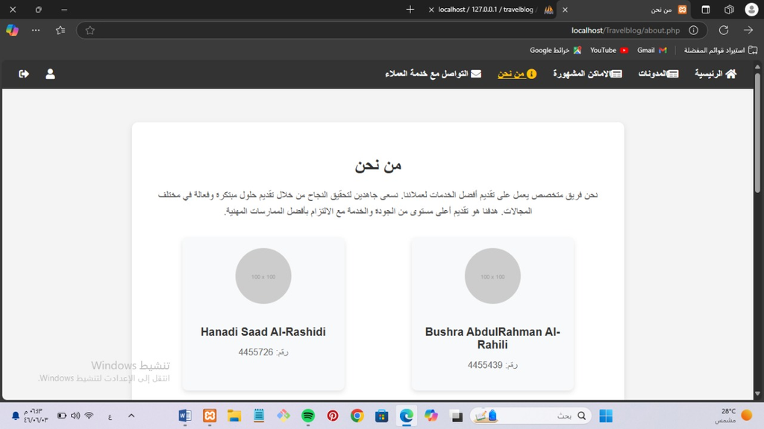
About Us
Includes a brief description of who we are.
Blog Rating

Slide 21

Customer Service Contact Page

Slide 22
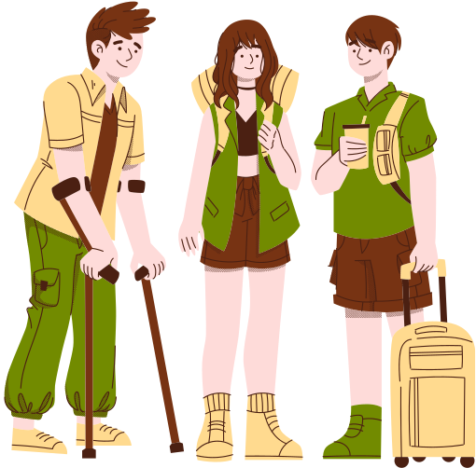

CONCLUSION
Our goal in this site was to create a way for tourists and residents of the Kingdom of Saudi Arabia to reach all destinations in our Kingdom.

Slide 23
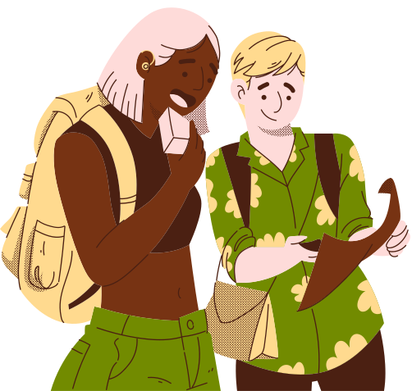

Thank You

